Slide 1
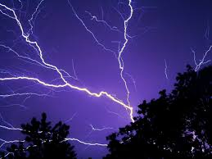
UNIT I - Electrostatics, Magnetostatics and Electrodynamics
Electric & Magnetic (EM) fields and forces are the basis of modern electrical systems
EM represents an essential and fundamental background that underlies future advances in energy systems
Understanding of electric fields is important for understanding the operating principles of many semiconductor and nanotechnology devices such as Computer chip Design and circuits
Lightning is an electrostatic discharge that travels between two charged regions.

Slide 2
ELECTRIC FIELDS
Objective
To define electric field by means of electric field lines
To calculate electric field due to
Point Charge
continuous charge distributions using Coulomb’s law

Slide 3
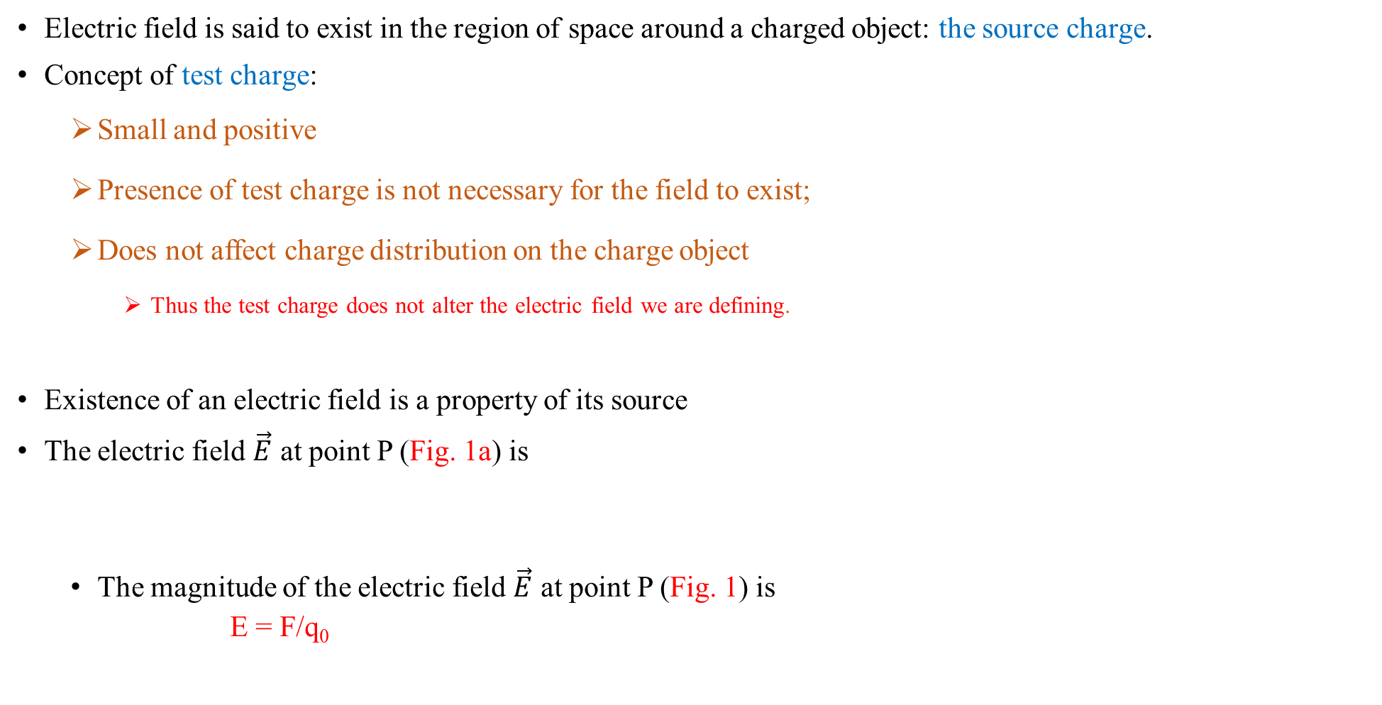
Electric Field
Electric field is said to exist in the region of space around a charged object: the source charge.
Concept of test charge:
Small and positive
Presence of test charge is not necessary for the field to exist;
Does not affect charge distribution on the charge object
Thus the test charge does not alter the electric field we are defining.
Existence of an electric field is a property of its source
The electric field $\vec{E}$ at point P (Fig. 1a) is
The magnitude of the electric field $\vec{E}$ at point P (Fig. 1) is
E = F/q₀
Fig. 1: (a) The electrostatic force acting on a positive test charge near a sphere of uniform negative charge.

Slide 4
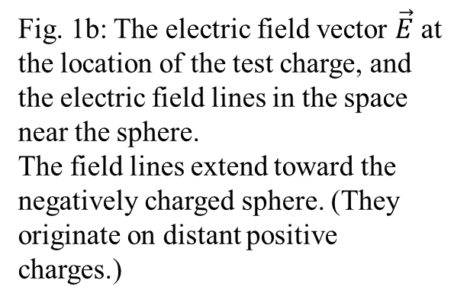
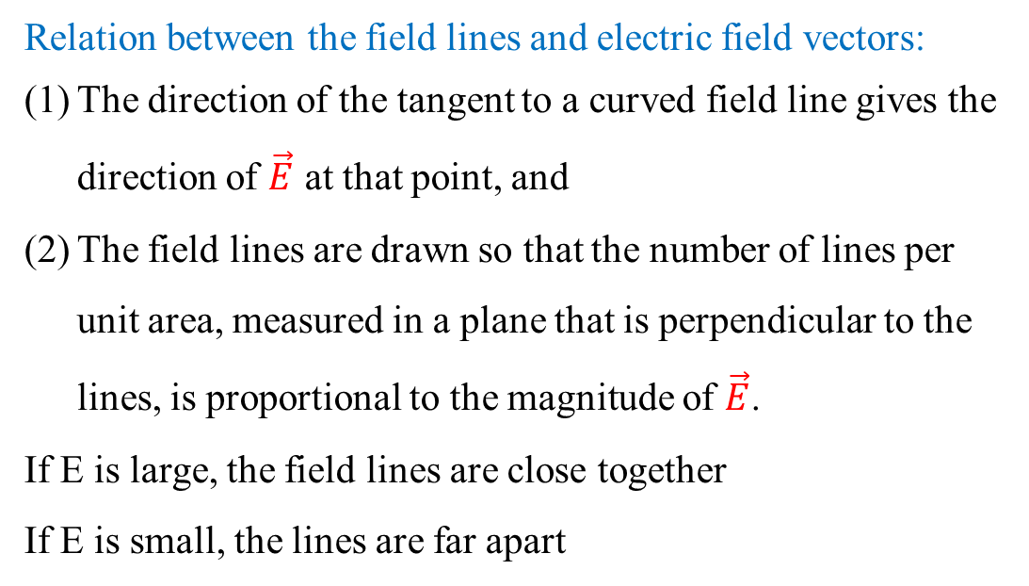
To visualize electric fields
Michael Faraday, who introduced the idea of electric fields in the 19th century, thought of the space around a charged body as filled with lines of force.
Electric field lines, provide a nice way to visualize patterns in electric fields (Fig. 1b)
Relation between the field lines and electric field vectors:
The direction of the tangent to a curved field line gives the direction of $\vec{E}$ at that point, and
The field lines are drawn so that the number of lines per unit area, measured in a plane that is perpendicular to the lines, is proportional to the magnitude of $\vec{E}$.
If E is large, the field lines are close together
If E is small, the lines are far apart
Fig. 1b: The electric field vector $\vec{E}$ at the location of the test charge, and the electric field lines in the space near the sphere.
The field lines extend toward the negatively charged sphere. (They originate on distant positive charges.)

Slide 5
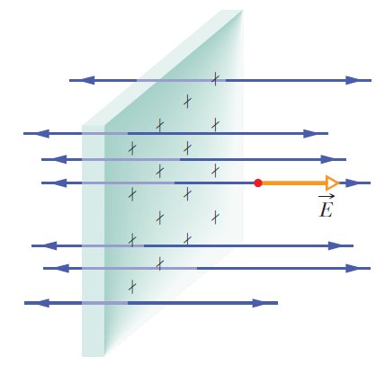
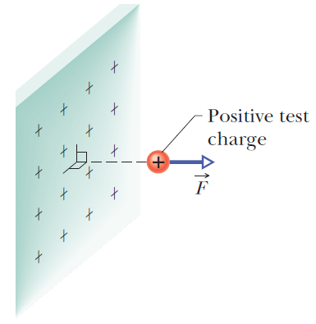
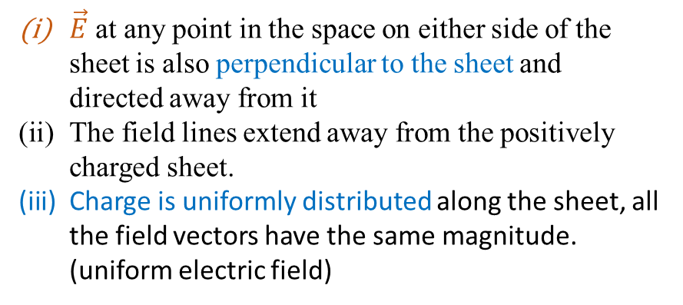
Electrostatic force $\vec{F }$, electric field vector $\vec{E}$ and electric field lines of an infinitely large, nonconducting sheet
with uniformly distributed positive charge on one side
(a)
(b)
(c) Side view of (b)
Net electrostatic force acting on the test charge would be perpendicular to the sheet, because forces acting in all other directions would cancel one another as a result of the symmetry.
Net force on the test charge would point away from the sheet
$\vec{E}$ at any point in the space on either side of the sheet is also perpendicular to the sheet and directed away from it
The field lines extend away from the positively charged sheet.
Charge is uniformly distributed along the sheet, all the field vectors have the same magnitude. (uniform electric field)

Slide 6
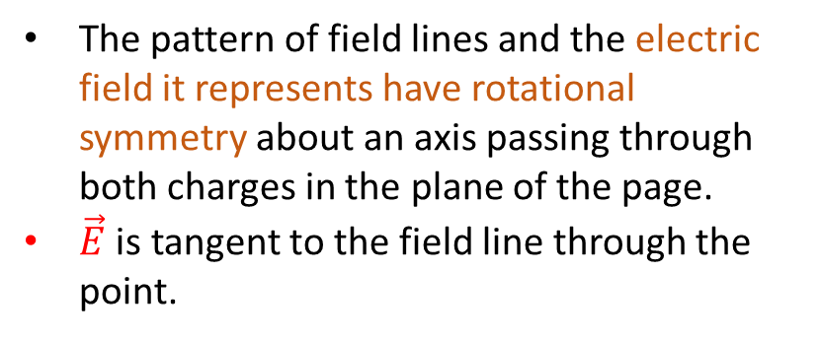
Field lines for two equal positive point charges.
The pattern of field lines and the electric field it represents have rotational symmetry about an axis passing through both charges in the plane of the page.
$\vec{E}$ is tangent to the field line through the point.
Field lines for two equal positive charges
Field lines for a positive point charge and a nearby negative point charge that are equal in magnitude.

Slide 7
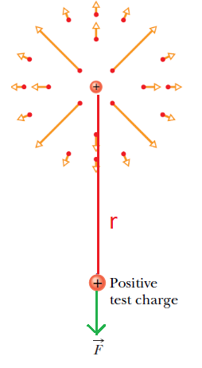
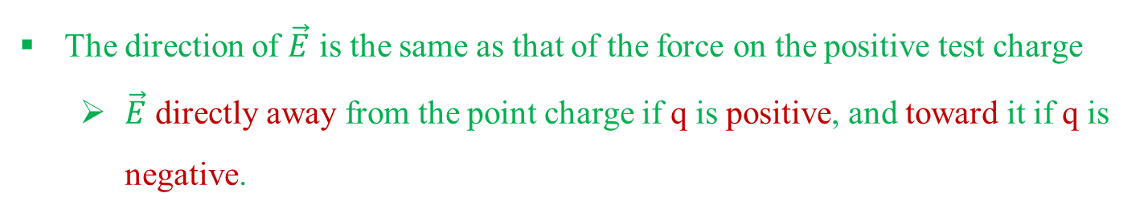
To find the Electric Field Due to a Point Charge (Positively charged)
Put a positive test charge q₀ at that point as shown in Fig 2.
From Coulomb’s law, the electrostatic force acting on q₀ is
The direction of $\vec{E}$ is the same as that of the force on the positive test charge
$\vec{E}$ directly away from the point charge if q is positive, and toward it if q is negative.
Net (or resultant), electric field due to more than one point charge
Placing positive test charge q0 near n point charges q₁, q₂,..., q_{n};
Net force $\vec{F_{0}}$from the n point charges acting on the test charge is
Fig 2
This shows that the principle of superposition applies to electric fields as well as to electrostatic forces.

Slide 8
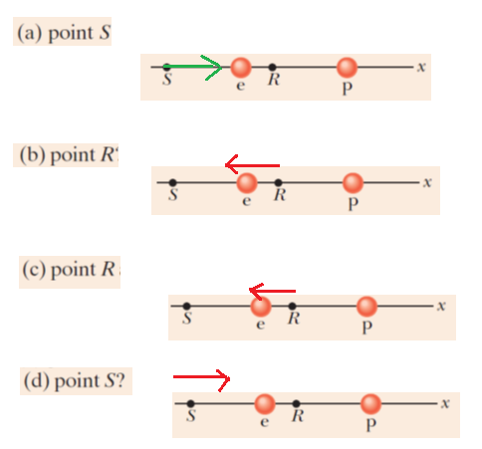

Slide 9
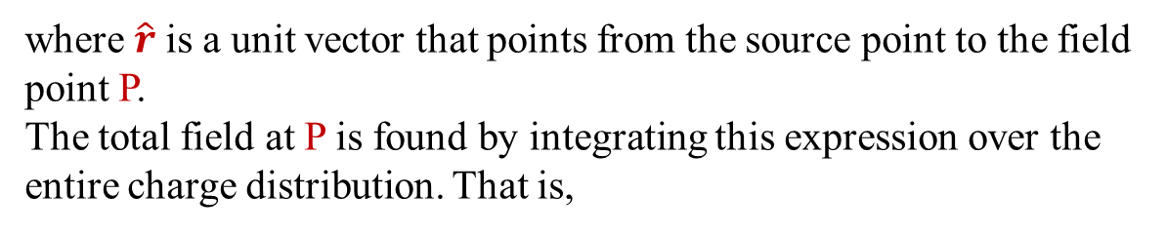
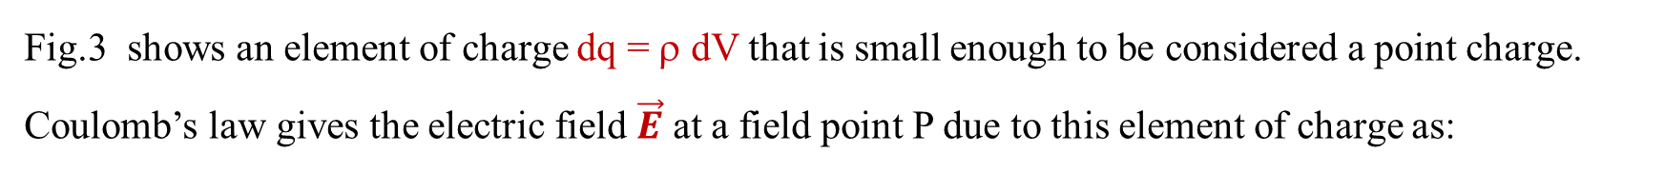

Calculating $\vec{E}$ From Coulomb’s Law
Fig.3 shows an element of charge dq = ρ dV that is small enough to be considered a point charge.
Coulomb’s law gives the electric field $\vec{E}$ at a field point P due to this element of charge as:
where $\hat{r}$is a unit vector that points from the source point to the field point P.
The total field at P is found by integrating this expression over the entire charge distribution. That is,
Fig.3
where dq = ρ dV
If the charge is distributed on a surface, we use dq =σ dA
For charge distributed on a line, we use dq =λ dL
and integrate over the surface or line.

Slide 10
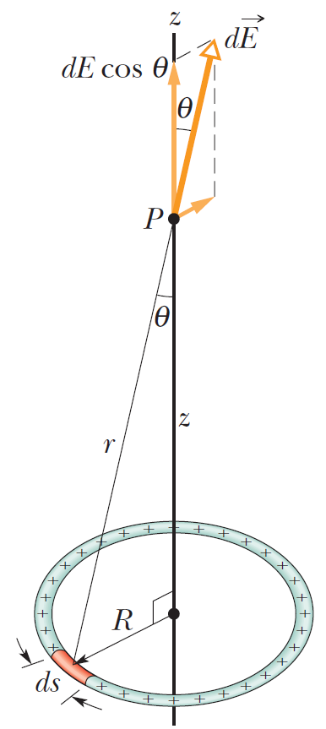
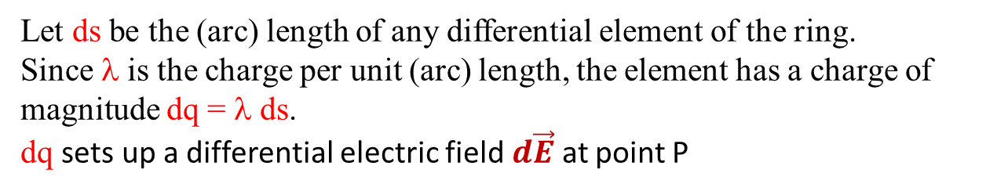


$\vec{E}$ on the Axis of a Ring Charge
Fig. 4 shows a thin ring of radius R with a uniform positive linear charge density λ around its circumference.
Assume the ring to be made of plastic or some other insulator, so that the charges can be regarded as fixed in place.
The perpendicular components just cancel but the parallel components add.
To Find $\vec{E}$ on the Axis of a Ring Charge
Step 1: Divide the ring into differential elements of charge that are so small that they are like point charges, and hence the equation below can be applied.
Step 2: Add the electric fields set up at P by all the differential elements. The vector sum of the fields gives us the field set up at P by the ring
Let ds be the (arc) length of any differential element of the ring.
Since λ is the charge per unit (arc) length, the element has a charge of magnitude dq = λ ds.
dq sets up a differential electric field $d\vec{E}$ at point P
A ring of uniform positive charge.
A differential element of charge occupies a length ds (greatly exaggerated for clarity).
This element sets up an electric field at point P.

Slide 11
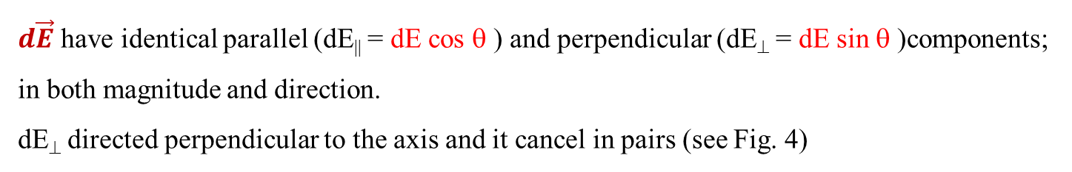
$\vec{E}$ on the Axis of a Ring Charge
Fig.4 shows that $d\vec{E}$ at point P is at angle θ to the central axis (which we have taken to be a z axis) and has components perpendicular to and parallel to that axis
Every charge element in the ring sets up a differential field at P, with magnitude given by
The perpendicular components just cancel but the parallel components add.
$d\vec{E}$ have identical parallel (dE|| = dE cos θ ) and perpendicular (dE⊥ = dE sin θ )components; in both magnitude and direction.
dE⊥ directed perpendicular to the axis and it cancel in pairs (see Fig. 4)
From the symmetry of the charge distribution, we can see that the net field due to the entire ring must lie along the axis of the ring; that is, the perpendicular components sum to zero.
Magnitude of E due to the Parallel component along the axis of the ring is
q: the total charge on the ring = λ(2πR)
Hence

Slide 12
Z >> R; the ring “looks like” a point charge. Hence we have
For a point at the center of the ring — that is, for z = 0; E = 0
This is because if we were to place a test charge at the center of the ring, there would be no net electrostatic force acting on it; the force due to any element of the ring would be canceled by the force due to the element on the opposite side of the ring.

